Slide 1
Design analysis and algorithm
Presenter: Srestha Sadhu
Panchali Datta Choudhury
Sudipto Kumar Mandal

Slide 2
Divide and conquer
In divide and conquer approach, the problem in hand, is divided into smaller sub-problems and then each problem is solved independently. When we keep on dividing the sub problems into even smaller sub-problems, we may eventually reach a stage where no more division is possible. Those "atomic" smallest possible sub-problem (fractions) are solved. The solution of all sub-problems is finally merged in order to obtain the solution of an original problem.

Slide 3
Broadly, we can understand divide-and-conquer approach in a three-step process.
Divide/Break
This step involves breaking the problem into smaller sub-problems. Sub-problems should represent a part of the original problem. This step generally takes a recursive approach to divide the problem until no sub-problem is further divisible. At this stage, sub-problems become atomic in nature but still represent some part of the actual problem.
Conquer/Solve
This step receives a lot of smaller sub-problems to be solved. Generally, at this level, the problems are considered 'solved' on their own.
Merge/Combine
When the smaller sub-problems are solved, this stage recursively combines them until they formulate a solution of the original problem. This algorithmic approach works recursively and conquer & merge steps works so close that they appear as one.

Slide 4
Examples
The following computer algorithms are based on divide-and conquer programming approach −
Merge Sort
Quick Sort
Binary Search
Strassen's Matrix Multiplication
Closest pair (points)
There are various ways available to solve any computer problem, but the mentioned are a good example of divide and conquer approach.

Slide 5
Quick Sort

Slide 6
Quick Sort
Quick Sort is a Divide and Conquer algorithm. It picks an element as pivot and partitions the given array around the picked pivot. There are many different versions of quick Sort that pick pivot in different ways.
Always pick first element as pivot.
Always pick last element as pivot (implemented below)
Pick a random element as pivot.
The key process in quick Sort is partition(). Target of partitions is, given an array and an element x of array as pivot, put x at its correct position in sorted array and put all smaller elements (smaller than x) before x, and put all greater elements (greater than x) after x. All this should be done in linear time.

Slide 7
Quick Sort
algorithm quicksort(A, lo, hi) is
if lo < hi then
p := partition(A, lo, hi)
quicksort(A, lo, p - 1)
quicksort(A, p + 1, hi)
algorithm partition(A, lo, hi) is
pivot := A[hi] i := lo
for j := lo to hi do
if A[j] < pivot then
swap A[i] with A[j]
i := i + 1
swap A[i] with A[hi]
return i

Slide 8
Worst Case Complexity [Big-O]: O(n²) It occurs when the pivot element picked is either the greatest or the smallest element. This condition leads to the case in which the pivot element lies in an extreme end of the sorted array. One sub-array is always empty and another sub-array contains n - 1 elements. Thus, quick sort is called only on this sub-array.
Best Case Complexity [Big-omega]: O(n*log n) It occurs when the pivot element is always the middle element or near to the middle element.

Slide 9
Merge Sort

Slide 10
Merge Sort
Merge Sort is a kind of Divide and Conquer algorithm in computer programming. It is one of the most popular sorting algorithms and a great way to develop confidence in building recursive algorithms

Slide 11
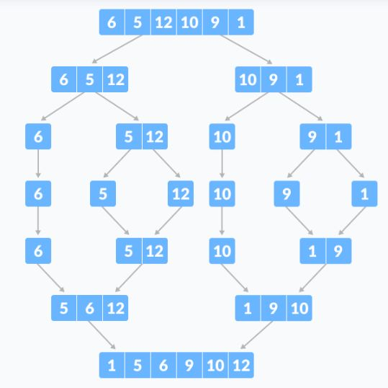

Slide 12
Merge Sort
In Divide and Conquer technique, we divide a problem into subproblems. When the solution to each subproblem is ready, we 'combine' the results from the subproblems to solve the main problem.
Suppose we had to sort an array A. A subproblem would be to sort a sub-section of this array starting at index p and ending at index r, denoted as A[p..r].
Divide
If q is the half-way point between p and r, then we can split the subarray A[p..r] into two arrays A[p..q] and A[q+1, r].
Conquer
In the conquer step, we try to sort both the subarrays A[p..q] and A[q+1, r]. If we haven't yet reached the base case, we again divide both these subarrays and try to sort them.

Slide 13
Merge Sort
Combine
When the conquer step reaches the base step and we get two sorted subarrays A[p..q] and A[q+1, r] for array A[p..r], we combine the results by creating a sorted array A[p..r] from two sorted subarrays A[p..q] and A[q+1, r].
The MergeSort function repeatedly divides the array into two halves until we reach a stage where we try to perform MergeSort on a subarray of size 1 i.e. p == r.
After that, the merge function comes into play and combines the sorted arrays into larger arrays until the whole array is merged.

Slide 14
Merge Sort
MergeSort(A, p, r):
if p > r
return
q = (p+r)/2
mergeSort(A, p, q)
mergeSort(A, q+1, r)
merge(A, p, q, r)

Slide 15
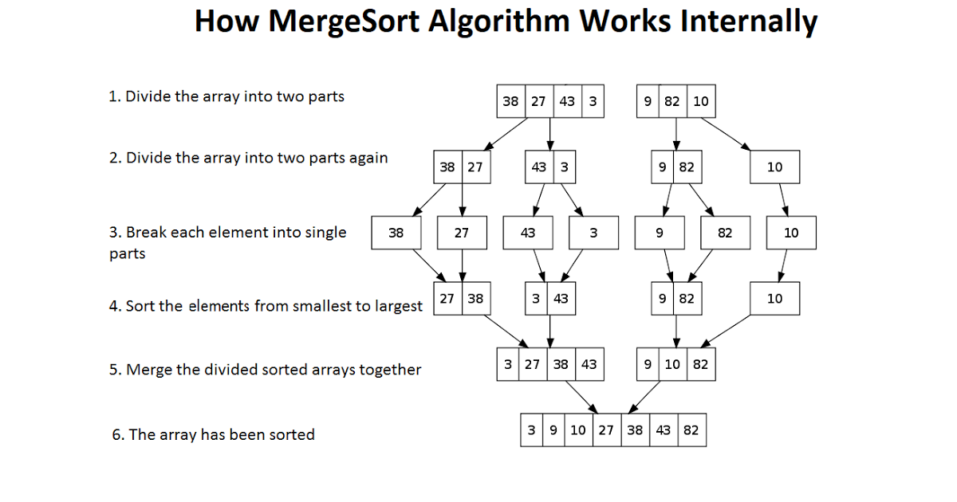

Slide 16
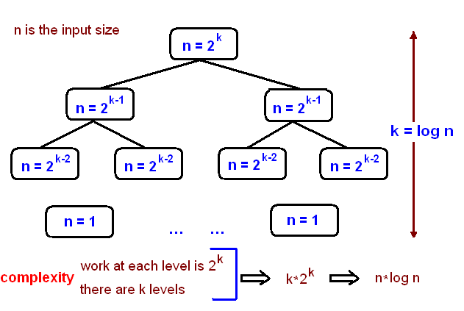

Slide 17
HEAP SORT

Slide 18
What is Complete Binary Tree?
A Complete binary tree is a binary tree in which every node other than the leaves has two children. In complete binary tree at every level, except possibly the last, is completely filled, and all nodes are as far left as possible.
If a Binary Tree is filled level by level, left to right (Left child followed by Right child) then it is called complete binary tree. If Right child is present without Left child then it is not complete

Slide 19
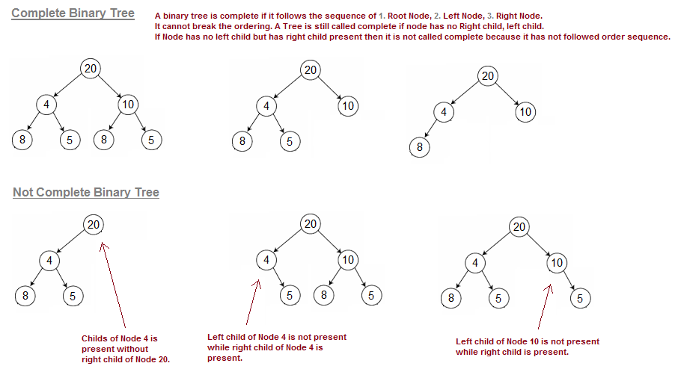

Slide 20
What is Heap property in Binary Tree?
A binary Tree is said to follow a heap property if tree is complete binary tree and every element of the tree is Larger (or Smaller) than any of its descendants if they exists. Depending on the ordering, a heap is called a max-heap or a min-heap. In a Max-heap, the keys of parent nodes are always greater than or equal to those of the children. In max-heap, Largest element of the Tree is always at top(Root Node). In a Min-heap, the keys of parent nodes are less than or equal to those of the children. In min-heap, Smallest element of the Tree is always at top(Root Node).

Slide 21
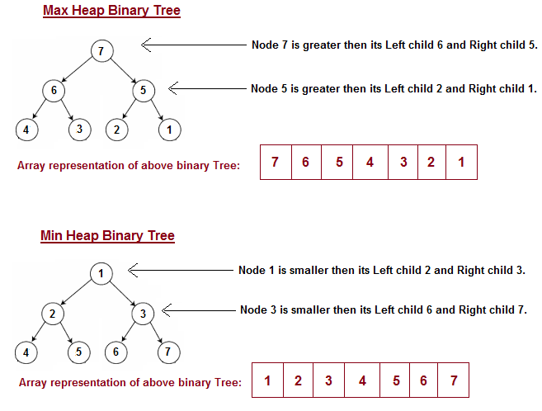

Slide 22
Important aspects of Heap sort. (Prerequisites)
Before going into Heap sort algorithm, Let's understand few points, If we have an array say [4, 10, 3, 5, 1], then we can represent array as complete binary tree (start adding nodes from left to right) like shown below.

Slide 23
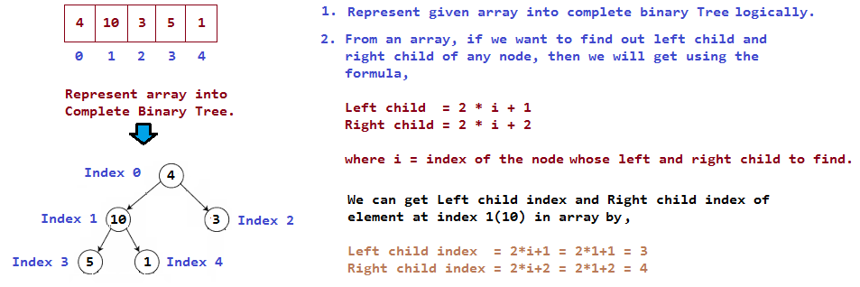

Slide 24
Each element has left and right child present in array except for leaf nodes, but how to find left and right child of non-leaf nodes in array. We will get left and right child of non leaf elements using formula,
Left child index = 2 * (index of root, whose left and right child to find) + 1 Right child index = 2 * (index of root, whose left and right child to find) + 1Left child and Right child of element at index 0 (element 4) is, Left child index = 2 * i + 1 = 2 * 0 + 1 = 1 Right child index = 2 * i + 2 = 2 * 0 + 2 = 2 Left child and Right child of element at index 1 (element 10) is, Left child index = 2 * i + 1 = 2 * 1 + 1 = 3 Right child index = 2 * i + 2 = 2 * 1 + 2 = 4

Slide 25
Left child and Right child of element at index 2 (element 3) is, Left child index = 2 * i + 1 = 2 * 2 + 1 = 5 (index 5 is greater than length of array, so element 3 has no left child) Right child index = 2 * i + 2 = 2 * 2 + 2 = 6 (index 6 is greater than length of array, so element 3 has no right child)

Slide 26
Algorithm
STEP 1: Logically, think the given array as Complete Binary Tree,
STEP 2: For sorting the array in ascending order, check whether the tree is satisfying Max-heap property at each node (For descending order, Check whether the tree is satisfying Min-heap property)Here we will be sorting in Ascending order,
STEP 3: If the tree is satisfying Max-heap property, then largest item is stored at the root of the heap(At this point we have found the largest element in array, Now if we place this element at the end(nth position) of the array then 1 item in array is at proper place.) We will remove the largest element from the heap and put at its proper place(nth position) in array.

Slide 27
After removing the largest element, which element will take its place? We will put last element of the heap at the vacant place. After placing the last element at the root, The new tree formed may or may not satisfy max-heap property. So, If it is not satisfying max-heap property then first task is to make changes to the tree, So that it satisfies max-heap property. (Heapify process: The process of making changes to tree so that it satisfies max-heap property is called heapify) When tree satisfies max-heap property, again largest item is stored at the root of the heap. We will remove the largest element from the heap and put at its proper place(n-1 position) in array. Repeat step 3 until size of array is 1 (At this point all elements are sorted.)

Slide 28
Heapify Process with Example
If parent node is not largest compared to its left and right child, then it finds the largest item among parent, its left and right child and replaces largest with parent node. It repeat the process for each node and at one point tree will start satisfying max-heap property. At this point, stop heapify process and largest element will be at root node. We found the largest element, Remove it and put it at its proper place in array, Put the last element of the tree at the place we removed the node(that is at root of the tree) Placing last node at the root may disturbed the max-heap property of root node.
So again repeat the Heapify process for root node. Continue heapify process until all nodes in tree satisfy max-heap property.

Slide 29
Heapify Process with Example
Initially, From which node we will start heapify process? Do we need to check each and every node that they satisfy heap property?
We do not have to look into leaf nodes as they don't have children and already satisfying max-heap property. So, we will start looking from the node which has at least one child present. How we will get that item in array, which has at least one child present?

Slide 30
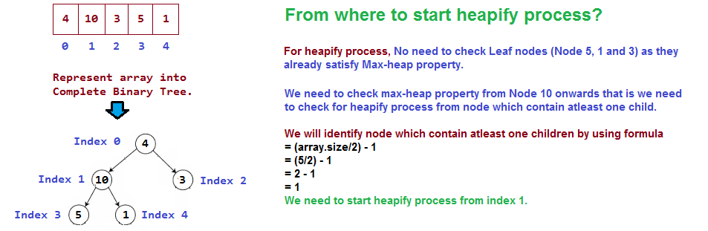
By using the formula (array. Length/2) - 1, we will be able to get the index of the item to start Heapify process.

Slide 31
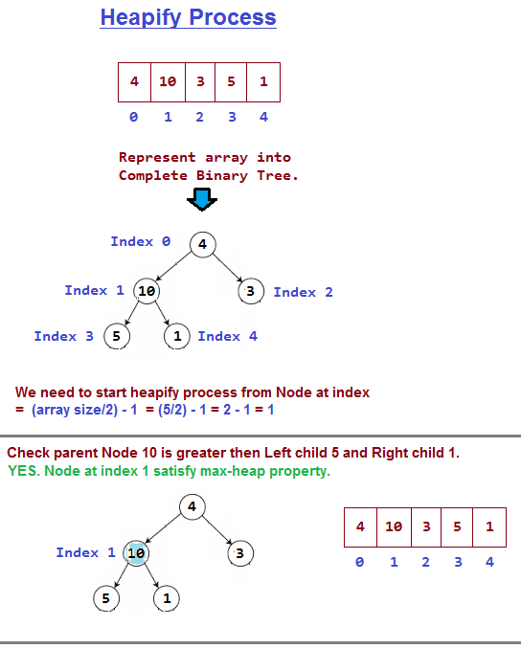

Slide 32
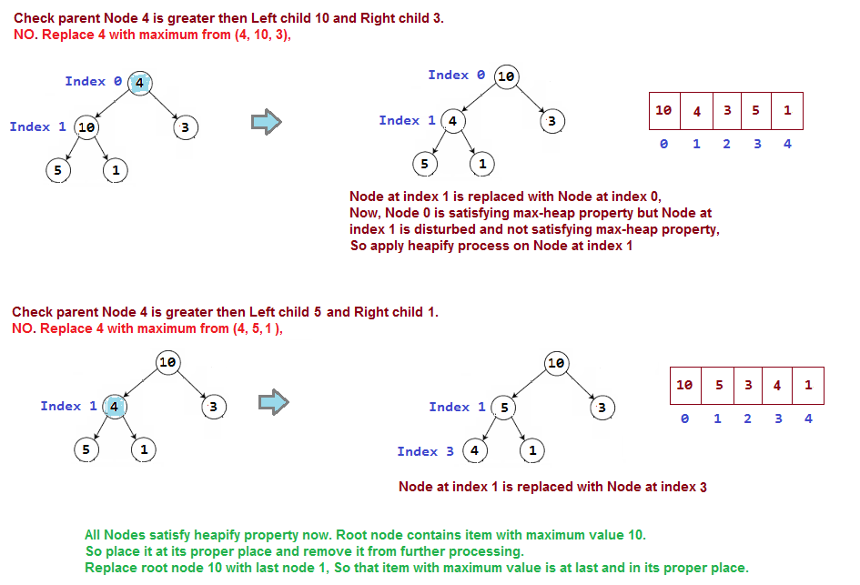

Slide 33
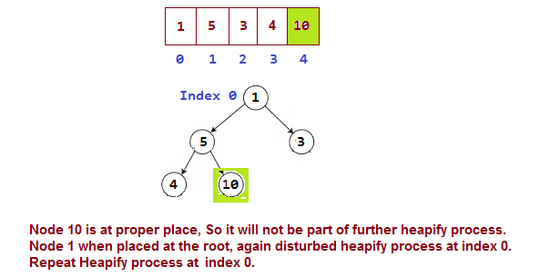

Slide 34
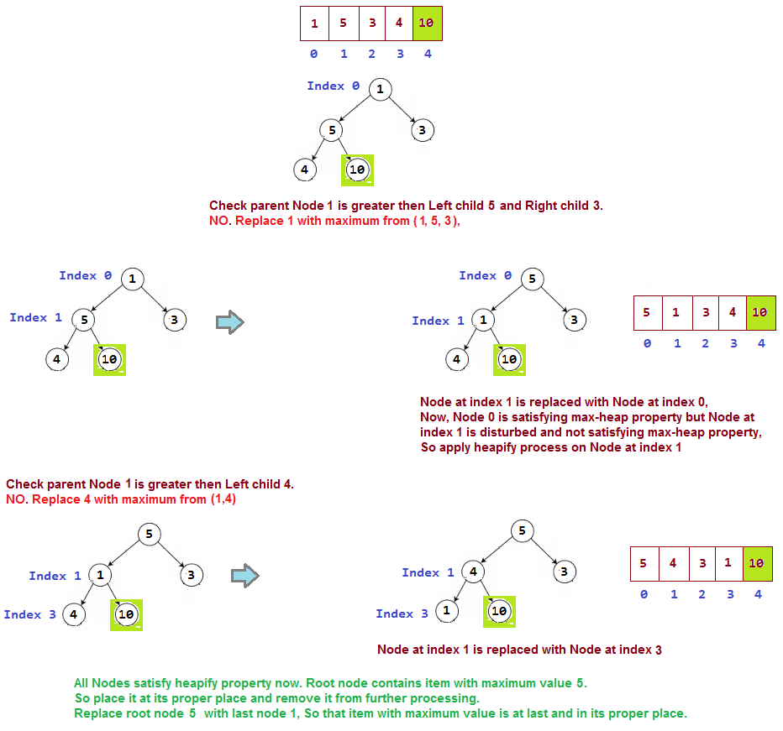

Slide 36
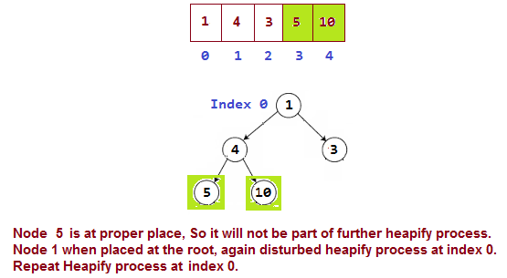

Slide 37
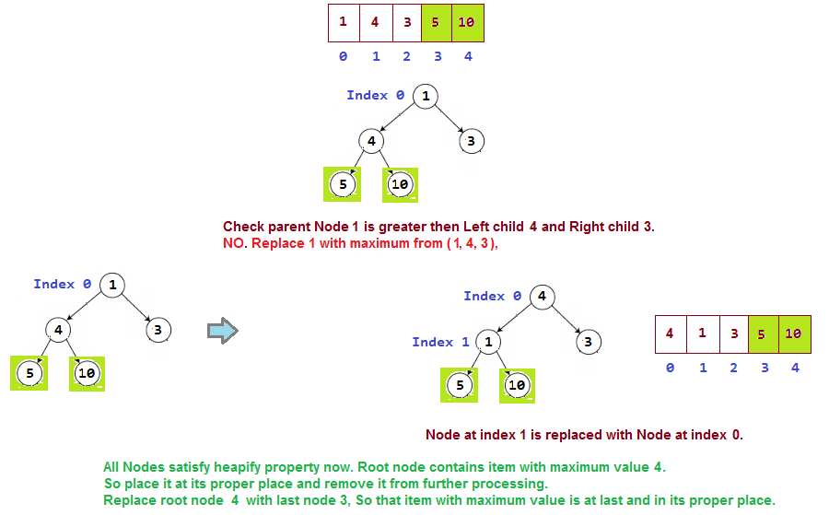

Slide 38
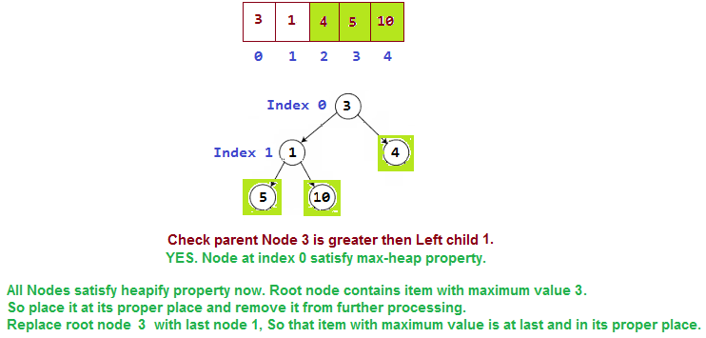

Slide 39
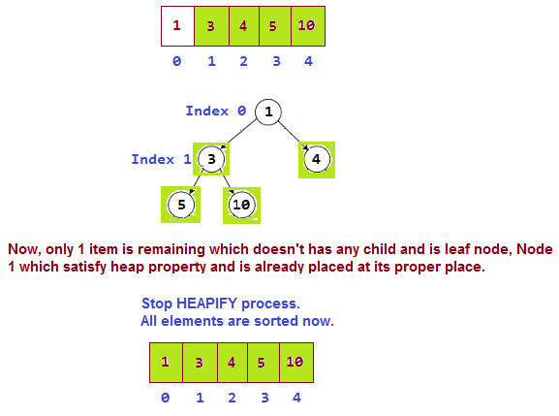

Slide 40
Time Complexity
Heap sort worst case, best case and average case time complexity is guaranteed O(n Log n). Heap sort space complexity is O(1)
Heap sort has the best possible worst case running time complexity of O(n Log n)
It doesn't need any extra storage and that makes it good for situations where array size is large.

Slide 41
HeapSort(A,n)
MakeHeap(A)
for i = n downto 2
Exchange A[1] with A[i]
n=n-1
Heapify(A,1)

Slide 42
Time Complexity
First MakeHeap(A)
O(nlgn) since heapify is O(lgn)
more exact analysis O(n)
then
n-1 swaps = O(n)
n-1 calls to Heapify = O(nlgn)
→ O(n) + O(n) + O (nlgn) = O(nlgn)

Slide 43
THANK YOU

